Slide 1
Using Descriptive Statistics

Slide 2
Populations and Samples
Parameters: summarizing the characteristics of individuals in the population
Population (everybody)
Sample
Statistics: summarizing the characteristics of individuals in the sample

Slide 3
Definitions
A population represents all of the individuals in a group to which you wish to generalize.
Since we can not know everyone in a population we study samples intended to represent the population.
Summaries of the measures of the characteristics of individuals in the population are called parameters.
Summaries of the measures of the characteristics of individuals in the sample are called statistics.

Slide 4
Populations and Samples
If we know everyone in the population then there is no need to guess at the summaries of the characteristics
Population (everybody)
Since samples are a subset of the population, sample summaries are used as a best guess (estimate) of the summaries of the population characteristics
Sample

Slide 5
Parameters and Statistics
Summaries of the measures of characteristics of individuals in a group
Measures of Central Tendency
The way in which data clusters around a central point
Measures of Variability
The degree to which data are spread away from the measure of central tendency

Slide 6
You first learned this in middle school: Measures of Central Tendency
Mode—the response that occurs most frequently
Median—the point where half of the scores are above and half below
Mean—average

Slide 7
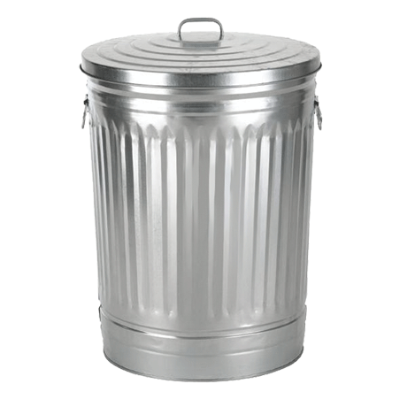
Sorting Data on Characteristics
Imagine a series of containers and your job is to take each piece of information and place it in one and only one appropriate container.
There are 3 ways to do this.

Slide 8
Nominal Variables
The containers have no logical order. The order of the containers conveys no information.
Allows comparison of group size. Which container has the most in it?
Mode is the only measure of central tendency that can be used.
Orange
Brown
Green
Red
Yellow
Blue

Slide 9
Ordinal Variables
The containers have a logical order. The order of the containers conveys information.
Although the containers are in order the distance between the contains may not be equal.
Median is the measure of central tendency that conveys the most information. Mode can be used also.
Rarely
Seldom
Occasionally
Half the Time
Usually
Almost Always

Slide 10
Interval Variables
The containers have a logical order. The order of the containers conveys information.
The containers are in order and the distance between the contains is equal.
Mean is the measure of central tendency that conveys the most information. Mode and median can be used also.
1 inch
2 inches
3 inches
4 inches
5 inches
6 inches …

Slide 11
A Special Case of Interval Scales Non-Ratio Scales
Interval scales that have no “zero” point.
Most measures of cognitive ability are non-ratio scales.
It is not appropriate to make ratio statements about measures of cognitive ability.

Slide 12
Ratio Scales
When “zero” on an interval scale represents an absence of the thing being measured it is called a ratio scale.
i.e., 80 centimeters is twice as long as 40 centimeters.
You are unlikely to ever statistically deal with ratio and non-ratio scales differently but it still important to know the difference to avoid making ratio statements about non-ratio data.

Slide 13
Measures of Variability (nominal)
Since nominal variables are often used as grouping variables (independent) reporting variation is not important
Nominal scales use measures of dispersion
Index of Qualitative Variation (IQV): 0 (all in one container to 1 (equal in all containers)
Search for IQV calculator

Slide 14
Measures of Variability (ordinal)
Range: distance between high and low value
OR
Quartiles: split the ordered data into 4 equal sized groups (the same number in each group)
Report the inter-quartile range (IQR): 25% point to 75% point
… median equals 10 (IQR = 7-15).
Note that the median will not necessarily be half way between the 25% and 75% points.

Slide 15
Measures of Variability (interval)
Standard deviation
Compute the average distance that all responses are from the mean

Slide 16
Same sample size.
Approximately the same mean.
Which one has the larger standard deviation?

Slide 17
Reporting Descriptive Statistics
In general, three numbers are always reported
Measure of central tendency
Measure of variability
Sample size
If the statistics from one or two groups are being reported, you may want to report these in the body of the text.
For more comparisons report statistics in a table.

Slide 18
Tables for Interval Data
Table 1
Mean Age and Standard Deviation of Middle School Students by Grade Level on the First Day of School
Grade Level N Mean SD
6th 124 11.62 .67
7th 119 12.75 .72
8th 104 13.91 .93

Slide 19
Computing Descriptive Statistics

Slide 20
What to remember?
Relationship of population, sample, parameter, and statistic
Measures of central tendency
Mean, median, mode
Variable types
Nominal, ordinal, interval (ratio)
Measures of variability
IQV, inter-quartile range, standard deviation

Slide 21
Populations and Samples
If we know everyone in the population then there is no need to guess at the summaries of the characteristics.
Since samples are used to develop estimates of the parameters, sometimes the statistics need to be adjusted to improve the estimates.
Population (everybody)
Sample

Slide 22
Computing Standard Deviation of a Population
Standard Deviation =
X = mean
n = number of scores
∑ = sum (in this case, the sum of the differences of each score from the mean, squared)
The square root of the sum of squared differences divided by the group size.

Slide 23
Computing Standard Deviation of a Sample
Standard Deviation =
Degrees of freedom df
X = mean
n = number of scores
∑ = sum (in this case, the sum of the differences of each score from the mean, squared)
The square root of the sum of squared differences divided by the degrees of freedom
Adjusted population estimator

